Slide 1
EMTM 553: E-commerce Systems
Lecture 5: Security Threats
Insup Lee
Department of Computer and Information Science
University of Pennsylvania
lee@cis.upenn.edu
www.cis.upenn.edu/~lee

Slide 2
Three Scenarios
Alice buys a book from Bob’s book store.
Inter-corporate trading for Charlie’s Plastic Company.
Daisy electronic market.

Slide 3
Alice Buys a Book
Alice shops for a book on the internet using WWW.
She finds the desired book from Bob’s book store and makes the order using a web form provided by Bob’s.
Bob confirms that the order really comes from Alice’s.
She sends her credit card number, suitably encrypted.
The book is delivered through UPS.

Slide 4
Inter-Corporate Trading
Charlie’s Plastic Makers is a medium-sized company in Canada with long-established requirements for high-quality plastic which it buys from Plasticorp.
Plasticorp aims to reduce costs of customer transactions by using secure messaging with its regular customers.
Origin and confidentiality of all correspondence must be ensured.

Slide 5
Daisy's Electronic Market
Daisy is an entrepreneurial small businessperson who works from her home basement.
She buys items from suppliers willing to do business wholly electronically, repackages them, and sells them through a WWW storefront.
Effective marketing of the web page and very low overhead provide Daisy’s competitive edge.

Slide 6
What are the issues?
Accountability -- Security relevant activities on a system can be traced to individuals who may be held responsible for their actions
Availability -- System resources are safeguarded from tampering and are available for authorized users at the time and in the format needed
Access Control -- Access to the system resources is limited to authorized individuals, entities, or processes
Confidentiality -- Information is not accessed by or disclosed to unauthorized individuals, entities, or processes
Identification and Authentication -- Verification that the originator of a transaction is the originator
Integrity -- Information is not undetectably altered or destroyed by an unauthorized person or process
Non-repudiation -- Undeniable proof of participation by the sender and/or receiver in a transaction
Privacy – individual rights to nondisclosure

Slide 7
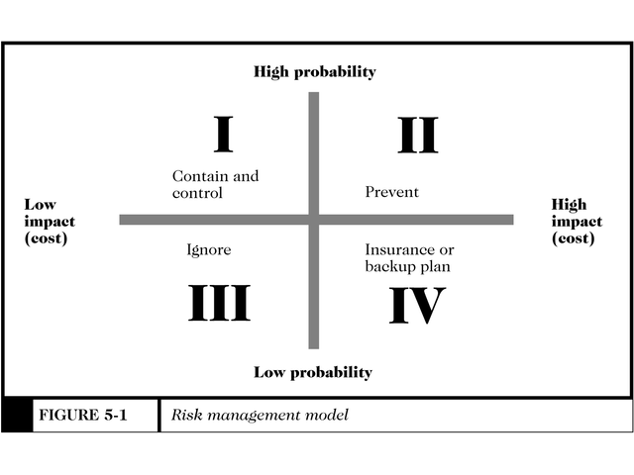
Security Overview (Figure 5-1)
Countermeasures are procedures, either physical or logical, that recognize, reduce, or eliminate a threat

Slide 8
What is Security?
Dictionary Definition: protection or defense against attack, interference, espionage, etc.
Computer Security Classification:
  Confidentiality (or Secrecy)
    Protecting against unauthorized data disclosure and ensuring the authenticity of the data’s source
  Integrity
    Preventing unauthorized data modification
  Availability (or Necessity)
    Preventing data delays or denials (removal)

Slide 9
Goals of Security
DATA
DATA
Confidentiality
DATA
Integrity
Availability
Source: GUNTER

Slide 10
Copyright and
Intellectual Property
Copyright
  Protecting expression
    Literary and musical works
    Pantomimes and choreographic works
    Pictorial, graphic, and sculptural works
    Motion pictures and other audiovisual works
    Sound recordings
    Architectural works

Slide 11
Copyright and
Intellectual Property
Intellectual property
  The ownership of ideas and control over the tangible or virtual representation of those ideas
U.S. Copyright Act of 1976
  Protects previously stated items for a fixed period of time
  Copyright Clearance Center
    Clearinghouse for U.S. copyright information

Slide 12
Security Policy and
Integrated Security
Security policy is a written statement describing what assets are to be protected and why, who is responsible, which behaviors are acceptable or not
  Physical security
  Network security
  Access authorizations
  Virus protection
  Disaster recovery

Slide 13
Specific Elements of a Security Policy
Authentication
  Who is trying to access the site?
Access Control
  Who is allowed to logon and access the site?
Secrecy
  Who is permitted to view selected information
Data integrity
  Who is allowed to change data?
Audit
  What and who causes selected events to occur, and when?

Slide 14
Intellectual Property Threats
The Internet presents a tempting target for intellectual property threats
  Very easy to reproduce an exact copy of anything found on the Internet
  People are unaware of copyright restrictions, and unwittingly infringe on them
    Fair use allows limited use of copyright material when certain conditions are met

Slide 15
Intellectual Property Threats
Cybersquatting
  The practice of registering a domain name that is the trademark of another person or company
    Cybersquatters hope that the owner of the trademark will pay huge dollar amounts to acquire the URL
    Some Cybersquatters misrepresent themselves as the trademark owner for fraudulent purposes

Slide 16
Three components to security
Three perspectives
  User’s point of view
  Server’s point of view
  Both parties
Three parts
  Client-side security
  Server-side security
  Document confidentiality

Slide 17
What can go wrong?
Risks that affect both client and server
  Eavesdropping
  Fraud
Risks to the end user
  Active content
  Privacy infringement
Risks to the web site
  Webjacking
  Server and LAN break-ins
  Denial-of-service attacks

Slide 18
Client-side security
Measures to protect the user’s privacy and the integrity of his computer
Example technological solutions
  Protection from computer viruses and other malicious software
  Limit the amount of personal information that browser’s can transmit without the user’s consent
  Any others?

Slide 19
Server-side security
Measures to protect the server and the machine it runs from break-ins, site vandalism, and denial-of-service attacks.
Solutions range
  installing firewall systems
  tightening operating systems security measures

Slide 20
Document confidentiality
Measures to protect private information from being disclosed to third parties.
Example risks:
Solutions range
  Password to identify users
  Cryptography

Slide 21
Electronic Commerce Threats
Client Threats
  Active Content
    Java applets, Active X controls, JavaScript, and VBScript
    Programs that interpret or execute instructions embedded in downloaded objects
    Malicious active content can be embedded into seemingly innocuous Web pages
    Cookies remember user names, passwords, and other commonly referenced information

Slide 22
Downloaded software
Sandboxing: encapsulate programs in a box but be liberal on what to accept
  Java sandbox confines Java applet actions to a security model-defined set of rules
  Rules apply to all untrusted applets, applets that have not been proven secure
Verification: analyze code before executing but then minimize runtime checks
  proof-carrying code
Certification: trust someone else to analyze code and execute with no checking
  Signed Java applets contain embedded digital signatures which serve as a proof of identity

Slide 24
ActiveX Controls
ActiveX is an object, called a control, that contains programs and properties that perform certain tasks
ActiveX controls only run on Windows 95, 98, or 2000
Once downloaded, ActiveX controls execute like any other program, having full access to your computer’s resources

Slide 25
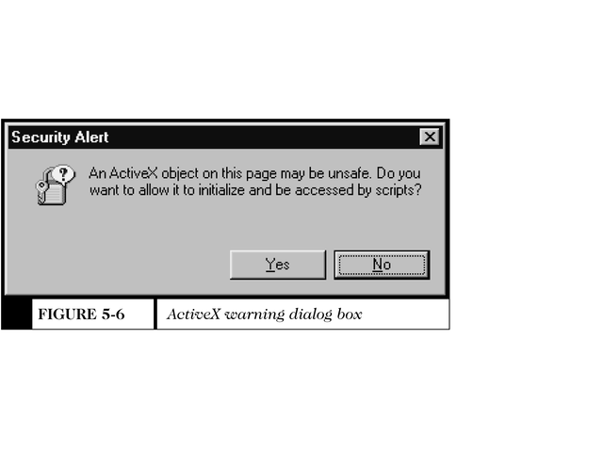
ActiveX Warning Dialog box
Figure 5-6

Slide 26
Graphics, Plug-ins, and
E-mail Attachments
Code can be embedded into graphic images causing harm to your computer
Plug-ins are used to play audiovisual clips, animated graphics
  Could contain ill-intentioned commands hidden within the object
  http://home.netscape.com/plugins/
E-mail attachments can contain destructive macros within the document

Slide 27
Communication Channel Threats
Secrecy Threats
  Secrecy is the prevention of unauthorized information disclosure
  Privacy is the protection of individual rights to nondisclosure
  Theft of sensitive or personal information is a significant danger
  Your IP address and browser you use are continually revealed while on the web

Slide 28
Communication Channel Threats (2)
Anonymizer
  A Web site that provides a measure of secrecy as long as it’s used as the portal to the Internet
  http://www.anonymizer.com
Integrity Threats
  Also known as active wiretapping
  Unauthorized party can alter data
    Change the amount of a deposit or withdrawal

Slide 29
Communication Channel Threats (3)
Availability Threats
  Also known as delay or denial threats
  Disrupt normal computer processing
    Deny processing entirely
    Slow processing to intolerably slow speeds
    Remove file entirely, or delete information from a transmission or file
    Divert money from one bank account to another

Slide 30
Server Threats
The more complex software becomes, the higher the probability that errors (bugs) exist in the code
Servers run at various privilege levels
  Highest levels provide greatest access and flexibility
  Lowest levels provide a logical fence around a running program

Slide 31
Server Threats (2)
Confidentiality violations occur when the contents of a server’s folder names are revealed to a Web browser
Administrators can turn off the folder name display feature to avoid secrecy violations
Cookies should never be transmitted unprotected
One of the most sensitive files on a Web server holds the username and password pairs
The Web server administrator is responsible for ensuring that this, and other sensitive files, are secure

Slide 32
IP Spoofing
Definition: attacker sends packets with forged source IP address in the TCP/IP header
IP spoofing is the basis for many DoS attacks
Spoofed packets are very hard to track back to their true source

Slide 33
Denial of Service Attacks
SYN flood
Land
Ping of death
Teardrop
Smurf
UDP flood
Distributed DoS

Slide 34
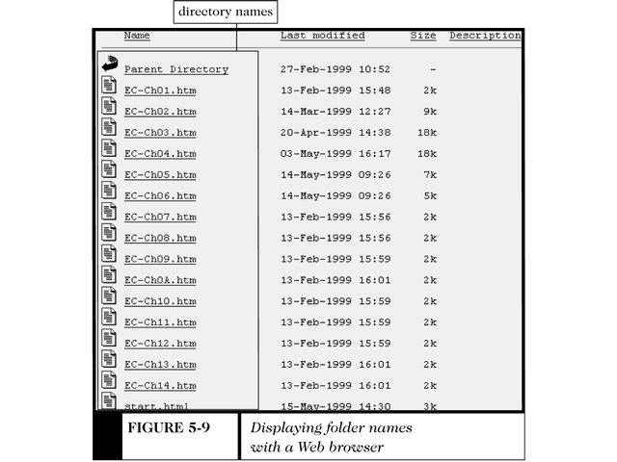
Displayed Folder Names
Figure 5-9

Slide 35
Database Threats
Disclosure of valuable and private information could irreparably damage a company
Security is often enforced through the use of privileges
Some databases are inherently insecure and rely on the Web server to enforce security measures

Slide 36
Other Threats
Common Gateway Interface (CGI) Threats
  CGIs are programs that present a security threat if misused
  CGI programs can reside almost anywhere on a Web server and therefore are often difficult to track down
  CGI scripts do not run inside a sandbox, unlike JavaScript

Slide 37
Other Threats (2)
Other programming threats include
  Programs executed by the server
  Buffer overruns can cause errors
  Runaway code segments
    The Internet Worm attack was a runaway code segment
  Buffer overflow attacks occur when control is released by an authorized program, but the intruder code instructs control to be turned over to it

Slide 38
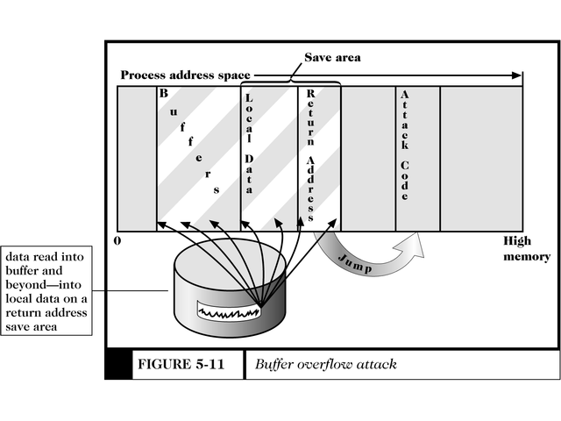
Buffer Overflow Attack
Figure 5-11

Slide 39
CERT Coordination Center
CERT (Computer Emergency Response Team)
Located at SEI (Software Engineering Institute) at Carnegie Mellon University
Responds to security events and incidents within the U.S. government and private sector
Posts CERT alerts to inform Internet users about recent security events
www.cert.org

Slide 40
Q&A

